Slide 1
Video Forgery Detection
Neema Poulose
S4 B batch
Roll no:23

Slide 2
Introduction
It is an approach for automatic identification of object-based forged video encoded with advanced frameworks based on its GOP (Group Of Pictures) structure. The proposed approach contains two specific frame manipulation detectors for three categories of frames. In the construction of the frame manipulation detector, motion residuals are generated from the target video frame sequence. We regard the object based forgery in video frames as image tampering in the motion residuals, and employ the feature extractors which are originally built for frequency domain image steganalysis to extract forensic features from the motion residuals. The experiments show that the proposed approach achieves excellent results

Slide 3
Relevance of the topic
The trustworthiness of digital media is decreasing due to the fact that it has
become really easy to alter and tamper the digital content flawlessly and thus,
there is a need to verify the originality and authenticity of media contents. In
view of this problem, this project is a method to classify the object based-
forged content.

Slide 4
Objective of the study
To develop an approach for automatic identification of object-based forged
video which is encoded with advanced frameworks based on its GOP (Group
Of Pictures) structure.

Slide 5
Description of the project
Object-based forgery adds new objects to a video scene or removes existing objects from it. To generate a forged video:
1.Decompress the video into individual frames and each frame is regarded as a still image.
2.The frames in the selected segments of the sequence are tampered while the rest frames remain untouched.
3.The resulting frame sequence is re-compressed to generate a forged version.

Slide 6
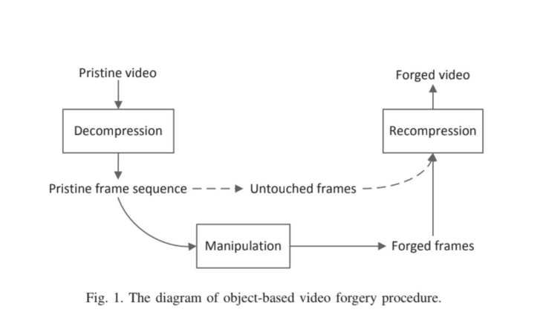

Slide 7
Existing System
The main purpose of our research work is to identify videos that have been tampered especially [6,7,8] those that can be useful in judicial cases. From time to time many research works has been taken place to find the tampered location [9,10,11,12]. Various methods such as active and passive methods can be used but passive approach [13] have proven to be more effective than the active methods as they do not interfere with the video in any way. These techniques are used to find many tampering types like double compression, frame duplication [14], frame deletion [15,16], and multiple compression [17]. Videos can be an important evidence in related judicial cases and with the help of video forensics [18] these videos are handled in proper way. We use hashing method to check the integrity of the frames and detect if the videos have been tampered or not. Hashing techniques such as MD5 or SHA proved effective for texts but when it comes to images/videos they do not prove to be ideal. So better algorithms have to be introduced to detect tampering in videos. The Difference-hashing or the D-Hash algorithm is used in our project as it proves to be more effective in terms of accuracy and time.

Slide 8
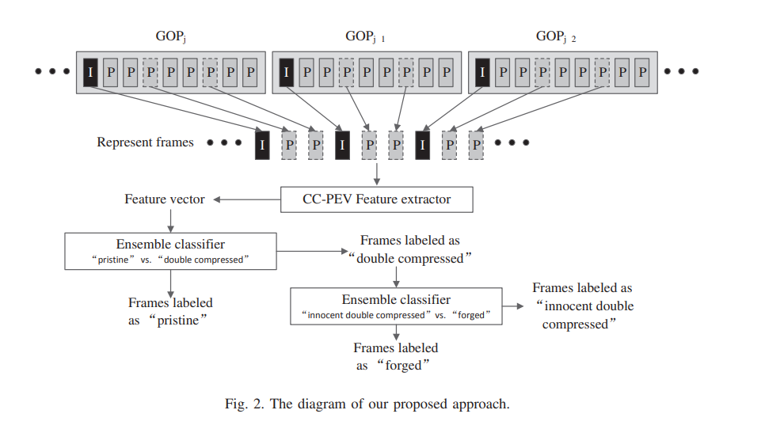
Proposed System

Slide 9
Methodology
Select represent frames and construct their motion residuals. Extract feature vector for each motion residual using CC-PEV feature set. Feature vector acts as an input to Ensemble classifier which judges an input frame as “forged” or “innocent double compressed”. A GOP structure is marked as “forged” if all the represent I frames and P/B frames are labeled as “forged” by the “innocent double compressed” vs. “forged” classifier. If there are at least one “forged” GOP structure in the suspicious video clip, it is considered to be a forged video clip, otherwise the suspicious video clips is indeed an innocent double compressed one.

Slide 10
Modules
1.Extract frames from a video
2.Extract CC-PEV features
3.Train ensemble classifier with given features.
4. Test the classifier on new datasets.

Slide 11
Input/Output
Libraries used-CCPEV-548,Ensemble classifier
Dataset-COCOVIDEO dataset
Front end:Django,CSS,Html
Back end:Python

Slide 12
References
[1] A. Rocha, W. Scheirer, T. Boult, and S. Goldenstein, “Vision of the unseen: current trends and challenges in digital image and video forensics,” ACM Computing Surveys, vol. 43, no. 4, pp. 26–40, 2011.
[2] D. Liao, R. Yang, H. Liu, et al., “Double H.264/AVC compression detection using quantized nonzero AC coefficients,” in Proc. SPIE, Media Watermarking, Security, and Forensics III , 78800Q, 2011.
[3] M.C. Stamm, W.S. Lin, and K.J.R. Liu, “Temporal forensics and antiforensics for motion compensated video,” IEEE Trans. Inf. Forensics Security, vol. 7, no. 4, pp. 1315–1329, 2012.
[4] J. Zhang, Y. Su, and M. Zhang, “Exposing digital video forgery by ghost shadow artifact,” in Proc. 1st ACM Workshop on Multimedia in Forensics, (MiFor 09), pp. 49–54, 2009.

Slide 13
THANK YOU

